Slide 1

COMPUTER ORGANIZATION AND ARCHITECTURE
M. Grace Mercy
Asst. Professor
Dept. of EECE, GIT
Visakhapatnam
gmatta@gitam.edu

Slide 2
UNIT II: Basic Computer Organization and Design
Instruction codes
computer registers
computer instructions
timing and control
instruction cycle
memory-references instructions
input-output and interrupt
complete computer description
Design of the basic computer, design of accumulator logic.
Micro programmed Control: Control memory, address sequencing, micro program example,
design of control unit.
Coursera →Computer Architecture offered by Princeton University
https://www.coursera.org/learn/comparch/home/welcome

Slide 3
Instruction codes
The organization of the computer is defined by its internal registers, the timing and control structure, and the set of instructions that it uses.
Internal organization of a computer is defined by the sequence of micro-operations it performs on data stored in its registers.
Computer can be instructed about the specific sequence of operations it must perform. User controls this process by means of a Program.
Program: set of instructions that specify the operations, operands, and the sequence by which processing has to occur.
Instruction: a binary code that specifies a sequence of micro-operations for the computer.
The computer reads each instruction from memory and places it in a control register. The control then interprets the binary code of the instruction and proceeds to execute it by issuing a sequence of micro-operations.
Every computer has its own unique instruction set. The ability to store and execute instructions and stored program concept is the most important property of a general purpose computer.

Slide 4

Instruction codes
Instruction Code: group of bits that instruct the computer to perform specific operation.
Instruction code is usually divided into two parts: Opcode and address(operand)
Operation Code (opcode):
group of bits that define the operation. Eg: add, subtract, multiply, shift, complement.
No. of bits required for opcode depends on total no. of operations available in computer.
The operation code must consist of at least n-bits for a given 2^{n} (or less) distinct operations.

Slide 5
Instruction codes
Operation Code (opcode):
The control unit receives the instruction from memory and interprets the operation code bits. It then issues a sequence of control signals to initiate microoperations in internal computer registers.
For this reason, an operation code is sometimes called a macrooperation because it specifies a set of microoperations.
Address (operand):
specifies the location of operands (registers or memory words)
Memory words are specified by their address
Registers are specified by their k-bit binary code that specify one of 2^{k} registers.

Slide 6
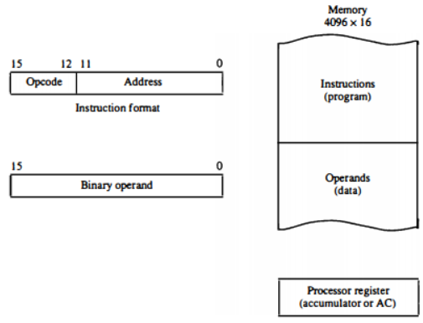
Stored Program Organization
The simplest way to organize a computer is to have one processor register and an instruction code format with two parts.
The first part specifies the operation to be performed and the second specifies an address. The memory address tells the control where to find an operand in memory.
This operand is read from memory and used as the data to be operated on together with the data stored in the processor register.
The ability to store and execute instructions is the most important property of a general-purpose computer. That type of stored program concept is called stored program organization.

Slide 7
Stored Program Organization
Instructions are stored in one section of memory and data in another.
For a memory unit with 4096 words we need 12 bits to specify an address since 2¹² = 4096.
If we store each instruction code in one 16-bit memory word, we have available four bits for the operation code (abbreviated opcode) to specify one out of 16 possible operations, and 12 bits to specify the address of an operand.
Accumulator (AC): Computers that have a single-processor register usually assign to it the name accumulator
and label it AC.
The operation is performed with the memory operand and the content of AC.

Slide 8
Stored Program Organization
Addressing of Operand:
Sometimes convenient to use the address bits of an instruction code not as an address but as the actual operand.
When the second part of an instruction code specifies an operand, the instruction is said to have an immediate operand.
When the second part specifies the address of an operand, the instruction is said to have a direct address.
When second part of the instruction designate an address of a memory word in which the address of the operand is found such instruction have indirect address.

Slide 9
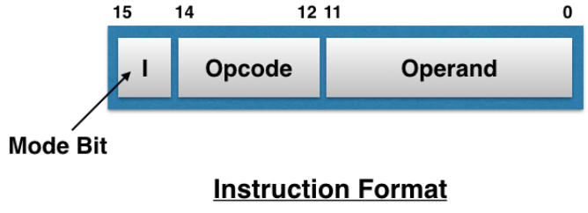
Stored Program Organization
Addressing of Operand:
One bit of the instruction code can be used to distinguish between a direct and an indirect address.
It consists of a 3-bit operation code, a 12-bit address, and an indirect address mode bit designated by I.
The mode bit is 0 for a direct address and 1 for an indirect address.

Slide 10
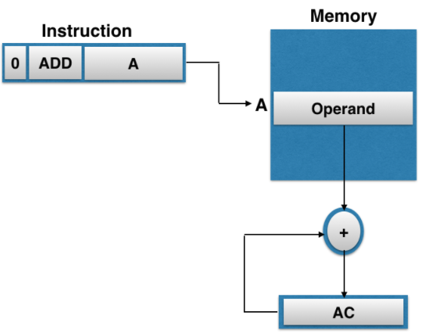
Direct addressing

Slide 11
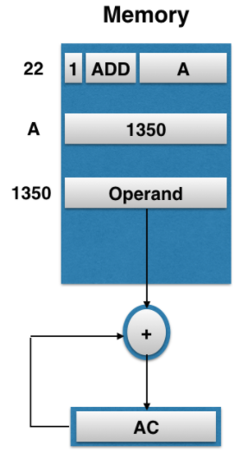
Indirect addressing

Slide 12
Problem
A computer uses a memory unit with 256Kwords of 32 bits each. A binary instruction code is stored in one word of memory. The instruction has four parts: an indirect bit. an operation code, a register code part to specify one of 64 registers, and an address part.
a. How many bits are there in the operation code, the register code part, and the address part?
b. Draw the instruction word format and indicate the number of bits in each part.
c. How many bits are there in the data and address inputs of the memory?

Slide 13
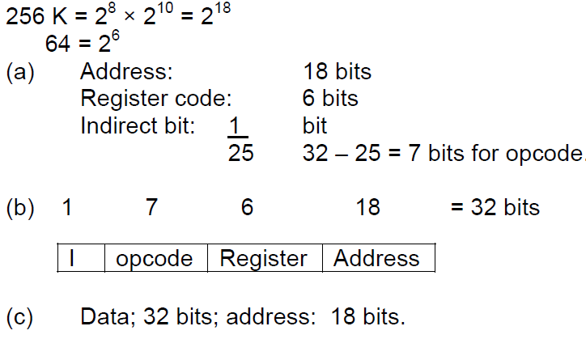
Problem
A computer uses a memory unit with 256Kwords of 32 bits each. A binary instruction code is stored in one word of memory. The instruction has four parts: an indirect bit. an operation code, a register code part to specify one of 64 registers, and an address part.
a. How many bits are there in the operation code, the register code part, and the address part?
b. Draw the instruction word format and indicate the number of bits in each part.
c. How many bits are there in the data and address inputs of the memory?
Solution:

Slide 14
Computer Registers
Computer instructions are normally stored in consecutive memory locations and are executed sequentially one at a time.
The control reads an instruction from a specific address in memory and executes it.
It then continues by reading the next instruction in sequence and executes it, and so on.
Need of the registers in computer:
Instruction sequencing needs a counter to calculate the address of the next instruction after execution of the current instruction is completed (PC).
Necessary to provide a register in the control unit for storing the instruction code after it is read from memory (IR).
Needs processor registers for manipulating data (AC and TR) and a register for holding a memory address (AR).

Slide 15
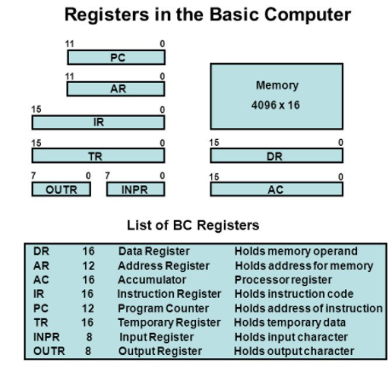
Computer Registers
The memory unit has a capacity of 4096 words and each word contains 16 bits.
Twelve bits of an instruction word are needed to specify the address of an operand.
This leaves three bits for the operation part of the instruction and a bit to specify a direct or indirect address.

Slide 16
Computer Registers
The data register (DR) holds the operand read from memory.
The accumulator (AC) register is a general purpose processing register.
The instruction read from memory is placed in the instruction register (IR).
The temporary register (TR) is used for holding temporary data during the processing.
The memory address register (AR) has 12 bits since this is the width of a memory address.
The program counter (PC) also has 12 bits and it holds the address of the next instruction to be read from memory after the current instruction is executed.
Two registers are used for input and output.
The input register (INPR) receives an 8-bit character from an input device.
The output register (OUTR) holds an 8-bit character for an output device.

Slide 17
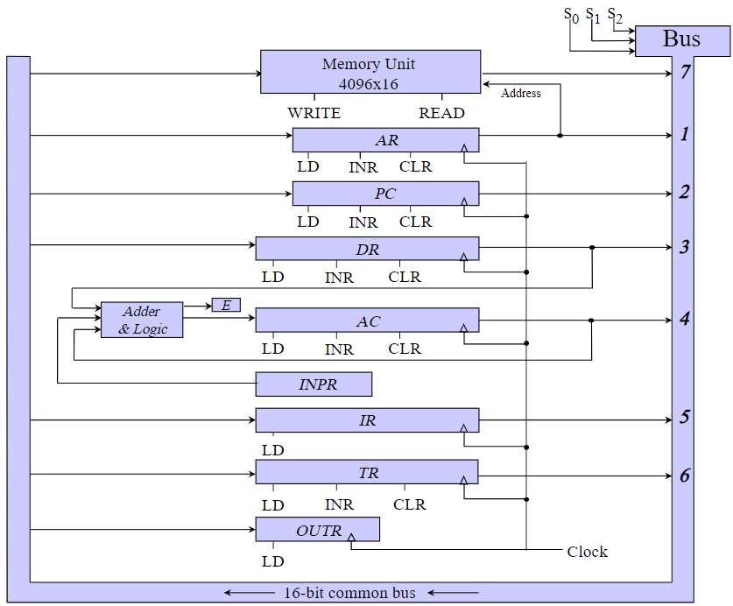
Common Bus System
The basic computer has eight registers, a memory unit, and a control unit.
Paths must be provided to transfer information from one register to another and between memory and registers.
A more efficient scheme for transferring information in a system with many registers is to use a common bus.
The connection of the registers and memory of the basic computer to a common bus system is shown in Fig.
The outputs of seven registers and memory are connected to the common bus.
The input data and output data of the memory are connected to the common bus, but the memory address is connected to AR.

Slide 18
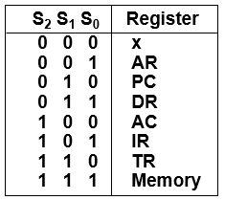
Common Bus System
The specific output that is selected for the bus lines at any given time is determined from the binary value of the selection variables S2, S1, and S0.
The number along each output shows the decimal equivalent of the required binary selection. For example, the number along the output of DR is 3. The 16-bit outputs of DR are placed on the bus lines when S2S1S0 = 011.
The lines from the common bus are connected to the inputs of each register and the data inputs of the memory.
The particular register whose LD (load) input is enabled receives the data from the bus during the next clock pulse transition.
Notes:
The particular register whose LD (load) input is enabled receives the data from the bus during the next clock pulse transition.
➢ The memory receives the contents of the bus when its write input is activated.
➢ The memory places its 16-bit output onto the bus when the read input is activated and S2S1S0 = 111.
➢ Two registers, AR and PC, have 12 bits each since they hold a memory address.
➢ When the contents of AR or PC are applied to the 16-bit common bus, the four most significant bits are set to 0's.
➢ When AR or PC receives information from the bus, only the 12 least significant bits are transferred into the register.
➢ The input register INPR and the output register OUTR have 8 bits each.
➢ They communicate with the eight least significant bits in the bus.
➢ INPR is connected to provide information to the bus but OUTR can only receive information from the bus.
➢ This is because INPR receives a character from an input device which is then transferred to AC.
➢ OUTR receives a character from AC and delivers it to an output device.
➢ Five registers have three control inputs: LD (load), INR (increment), and CLR (clear).
➢ This type of register is equivalent to a binary counter with parallel load and synchronous clear.
➢ Two registers have only a LD input.
➢ The input data and output data of the memory are connected to the common bus, but the memory address is connected to AR.
➢ Therefore, AR must always be used to specify a memory address.

Slide 19
Common Bus System
The memory receives the contents of the bus when its write input is activated.
The memory places its 16-bit output onto the bus when the read input is activated and S2S1S0 = 111.
Five registers have three control inputs: LD (load), INR (increment), and CLR (clear).
This type of register is equivalent to a binary counter with parallel load and synchronous clear.
Two registers have only a LD input. (IR, OUTR)

Slide 20
Common Bus System
The 16 inputs of AC come from an adder and logic circuit. This circuit has three sets of inputs.
One set of 16-bit inputs come from the outputs of AC.
Another set of 16-bit inputs come from the data register DR. The result of an addition is transferred to AC and the end carry-out of the addition is transferred to flip-flop E (extended AC bit).
A third set of 8-bit inputs come from the input register INPR.
Notes:
The content of any register can be applied onto the bus and an operation can be performed in the adder and logic circuit during the same clock cycle.
➢ For example, the two microoperations DR ←AC and AC ← DR can be executed at the same time.
➢ This can be done by placing the content of AC on the bus (with S2S1S0 = 100), enabling the LD (load) input of DR, transferring the content of DR through the adder and logic circuit into AC, and enabling the LD (load) input of AC, all during the same clock cycle.

Slide 21
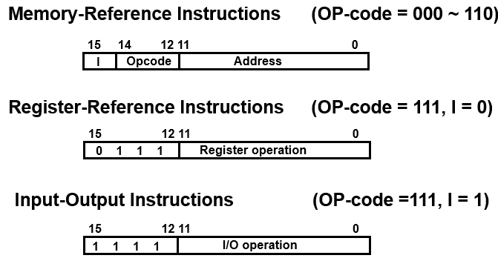
Computer Instructions
A memory-reference instruction uses 12 bits to specify an address and one bit to specify the addressing mode I. I is equal to 0 for direct address and to 1 for indirect address.
The register-reference instructions are recognized by the operation code 111 with a 0 in the leftmost bit (bit 15) of the instruction.
A register-reference instruction specifies an operation on the AC register. So an operand from memory is not needed. Therefore, the other 12 bits are used to specify the operation to be executed.
An input—output instruction does not need a reference to memory and is recognized by the operation code 111 with a 1 in the leftmost bit of the instruction. The remaining 12 bits are used to specify the type of input—output operation.

Slide 22

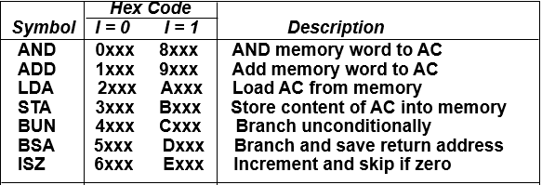
Memory-Reference
Instructions
Opcode = 000 ∼ 110
I=0 : 0xxx ~ 6xxx, I=1: 8xxx ~Exxx

Slide 23

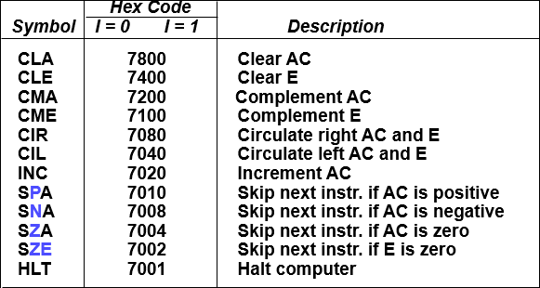
Register-Reference
Instructions
Opcode = 111
7xxx (7800 ~ 7001) : CLA, CMA, ….

Slide 24
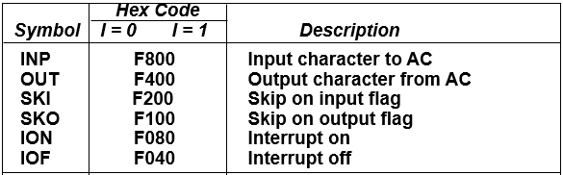
Input – Output
Instructions
Opcode = 000 ∼ 110
I=0 : 0xxx ~ 6xxx, I=1: 8xxx ~Exxx

Slide 25
Thank you

Slide 26
Instruction set completeness
A computer should have a set of instructions so that the user can construct machine language programs to evaluate any function that is known to be computable.
The set of instructions are said to be complete if the computer includes a sufficient number of instructions in each of the following categories.
1. Arithmetic, logical and shift instructions
2. Instructions for moving information to and from memory and processor register
3. Program control instructions together with instructions that check status conditions
4. Input and output instructions
Notes:
Arithmetic, logical, and shift instructions provide computational capabilities for processing the type of data that the user may wish to employ. The bulk of the binary
information in a digital computer is stored in memory, but all computations are done in processor registers. Therefore, the user must have the capability of moving information
between these two units. Decision making capabilities are an important aspect of digital computers. For example, two numbers can be compared, and if the first is greater than the
second, it may be necessary to proceed differently than if the second is greater than the first. Program control instructions such as branch instructions are used to change the sequence in
which the program is executed. Input and output instructions are needed for communication
between the computer and the user. Programs and data must be transferred into memory and
results of computations must be transferred back to the user.
There is one arithmetic instruction, ADD, and two related instructions, complement
AC (CMA) and increment AC (INC). With these three instructions we can add and subtract
binary numbers when negative numbers are in signed-2s complement representation.

Slide 27
Instruction set completeness
Arithmetic, logical, and shift instructions provide computational capabilities for processing the type of data that the user may wish to employ.
The bulk of the binary information in a digital computer is stored in memory, but all computations are done in processor registers. Therefore, the user must have the capability of moving information between these two units.
Decision making capabilities are an important aspect of digital computers. Program control instructions such as branch instructions are used to change the sequence in which the program is executed.
Input and output instructions are needed for communication between the computer and the user. Programs and data must be transferred into memory and results of computations must be transferred back to the user.
Notes:
Arithmetic, logical, and shift instructions provide computational capabilities for processing the type of data that the user may wish to employ. The bulk of the binary
information in a digital computer is stored in memory, but all computations are done in processor registers. Therefore, the user must have the capability of moving information
between these two units. Decision making capabilities are an important aspect of digital computers. For example, two numbers can be compared, and if the first is greater than the
second, it may be necessary to proceed differently than if the second is greater than the first. Program control instructions such as branch instructions are used to change the sequence in
which the program is executed. Input and output instructions are needed for communication
between the computer and the user. Programs and data must be transferred into memory and
results of computations must be transferred back to the user.
There is one arithmetic instruction, ADD, and two related instructions, complement
AC (CMA) and increment AC (INC). With these three instructions we can add and subtract
binary numbers when negative numbers are in signed-2s complement representation.

Slide 28
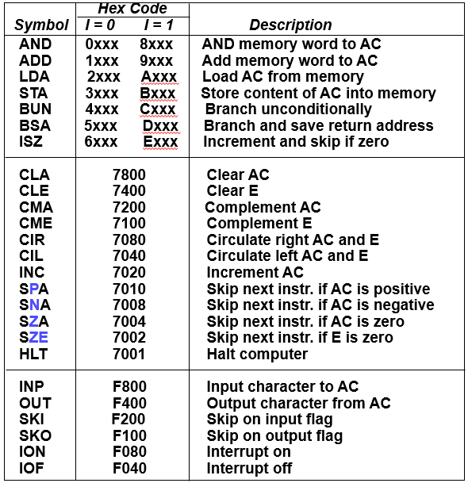
Instruction set completeness
Notes:
Arithmetic, logical, and shift instructions provide computational capabilities for processing the type of data that the user may wish to employ. The bulk of the binary
information in a digital computer is stored in memory, but all computations are done in processor registers. Therefore, the user must have the capability of moving information
between these two units. Decision making capabilities are an important aspect of digital computers. For example, two numbers can be compared, and if the first is greater than the
second, it may be necessary to proceed differently than if the second is greater than the first. Program control instructions such as branch instructions are used to change the sequence in
which the program is executed. Input and output instructions are needed for communication
between the computer and the user. Programs and data must be transferred into memory and
results of computations must be transferred back to the user.
There is one arithmetic instruction, ADD, and two related instructions, complement
AC (CMA) and increment AC (INC). With these three instructions we can add and subtract
binary numbers when negative numbers are in signed-2s complement representation.

Slide 29
Instruction set completeness
There is one arithmetic instruction, ADD, and two related instructions, complement AC (CMA) and increment AC (INC). With these three instructions we can add and subtract binary numbers when negative numbers are in signed-2s complement representation.
The circulate instructions, CIR and CIL, can be used for arithmetic shifts as well as any other type of shifts desired
Multiplication and division can be performed using addition, subtraction, and clear AC (CLA). The AND and complement provide a NAND operation.
Moving information from memory to AC is accomplished with the load AC (LDA) instruction. Storing information from AC into memory is done with the store.
Notes:
Arithmetic, logical, and shift instructions provide computational capabilities for processing the type of data that the user may wish to employ. The bulk of the binary
information in a digital computer is stored in memory, but all computations are done in processor registers. Therefore, the user must have the capability of moving information
between these two units. Decision making capabilities are an important aspect of digital computers. For example, two numbers can be compared, and if the first is greater than the
second, it may be necessary to proceed differently than if the second is greater than the first. Program control instructions such as branch instructions are used to change the sequence in
which the program is executed. Input and output instructions are needed for communication
between the computer and the user. Programs and data must be transferred into memory and
results of computations must be transferred back to the user.
There is one arithmetic instruction, ADD, and two related instructions, complement
AC (CMA) and increment AC (INC). With these three instructions we can add and subtract
binary numbers when negative numbers are in signed-2s complement representation.

Slide 30
Timing and Control
The timing for all registers in the basic computer is controlled by a master clock generator.
The clock pulses are applied to all flip-flops and registers in the system, including the flip-flops and registers in the control unit.
The clock pulses do not change the state of a register unless the register is enabled by a control signal.
The control signals are generated in the control unit and provide control inputs for the multiplexers in the common bus, control inputs in processor registers, and microoperations for the accumulator.

Slide 31
Control Unit
There are two major types of control organization, hardwired control and microprogrammed control.
In the hardwired organization, the control logic is implemented with gates, flip-flops, decoders, and other digital circuits. It has the advantage that it can be optimized to produce a fast mode of operation.
In the microprogrammed organization, the control information is stored in a control memory. The control memory is programmed to initiate the required sequence of microoperations.
A hardwired control requires changes in the wiring among the various components if the design has to be modified or changed.
In the microprogrammed control, any required changes or modifications can be done by updating the microprogram in control memory.

Slide 32
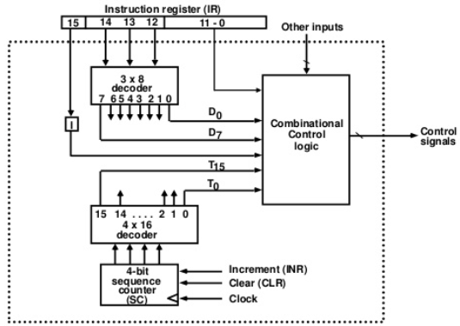
Timing and Control
Notes:
It consists of two decoders, a sequence counter, and a number of control logic gates. An instruction read from memory is placed in the instruction register ( IR ). The instruction register is shown again in Figure, where it is divided into three parts: the I bit, the operation code, and bits 0 through 11. The operation code in bits 12 through 14 are decoded with a 3 x 8 decoder. The eight outputs of the decoder are designated by the symbols D0 through D7 . The subscripted decimal number is equivalent to the binary value of the corresponding operation code. Bit 15 of the instruction is transferred to a flip-flop designated by the symbol I. Bits 0 through 11 are applied to the control logic gates. The 4-bit sequence counter can count in binary from 0 through 15. The outputs of the counter are decoded into 16 timing signals T0 through T15. The sequence counter SC can be incremented or cleared synchronously. Most of the time, the counter is incremented to provide the sequence of timing signals out of the 4 x 16 decoder. Once in awhile, the counter is cleared to 0, causing the next active timing signal to be T0 .

Slide 33
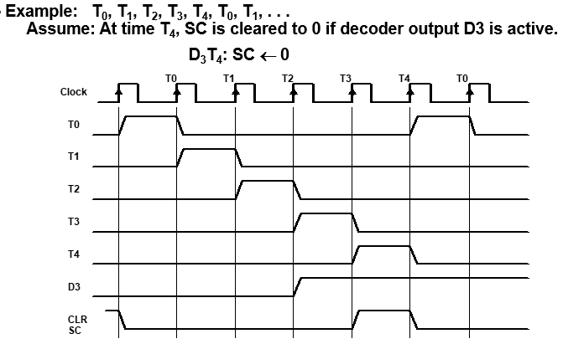
Timing and Signals
Generated by 4-bit sequence counter and 4×16 decoder
The SC can be incremented or cleared.
Notes:
As an example, consider the case where SC is incremented to provide timing signals T0, T2, T3, and T4 in sequence. At time T4 , SC is cleared to 0 if decoder output D3 is active.
The timing diagram shows the time relationship of the control signals. The sequence counter SC responds to the positive transition of the clock. Initially, the CLR input of SC is active. The first positive transition of the clock dears SC to 0, which in turn activates the timing signal T0 out of the decoder. T0 is active during one clock cycle. T0 in the diagram will trigger only those registers whose control inputs are connected to timing signal T0. SC is incremented with every positive clock transition, unless its CLR input is active. This produces the sequence of timing signals T0, T1, T2, T3, T4 and so on, as shown in the diagram, If SC is not cleared, the timing signals will continue with T5, T6, upto T15 and back to T0. The last three waveforms in Figure show how SC is cleared when D3 T4 = 1. Output D3 from the operation decoder becomes active at the end of timing signal T2 . When timing signal T4 becomes active, the output of the AND gate that implements the control function D3 T4 becomes active. This signal is applied to the CLR input of SC. On the next positive clock transition (the one marked T 4 in the diagram) the counter is cleared to 0. This causes the timing signal T0 to become active instead of T5 that would have been active if SC were incremented instead of cleared.

Slide 34
Instruction Cycle
A program residing in the memory unit of the computer consists of a sequence of instructions.
The program is executed in the computer by going through a cycle for each instruction. Each instruction cycle in turn is subdivided into a sequence of subcycles or phases.
In the basic computer each instruction cycle consists of the following phases:
1. Fetch an instruction from memory.
2. Decode the instruction.
3. Read the effective address from memory if the instruction has an indirect address.
4. Execute the instruction.
Upon the completion of step 4, the control goes back to step 1 to fetch, decode, and execute the next instruction.
This process continues indefinitely unless a HALT instruction is encountered.

Slide 35
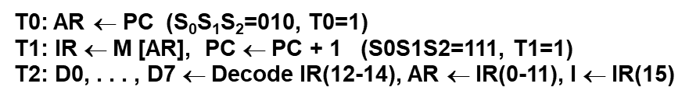
Fetch and Decode
Initially, the program counter PC is loaded with the address of the first instruction in the program.
The sequence counter SC is cleared to 0, providing a decoded timing signal T0.
After each clock pulse, SC is incremented by one, so that the timing signals go through a sequence T 0 , T i, T 2 , and so on.
The microoperations for the fetch and decode phases can be specified by the following register transfer statements.
Notes:
Since only AR is connected to the address inputs of memory, it is necessary to transfer the address from PC to AR during the clock transition associated with timing signal T0. The instruction read from memory is then placed in the instruction register IR with the clock transition associated with timing signal T1. At the same time, PC is incremented by one to prepare it for the address of the next instruction in the program. At time T2, the operation code in IR is decoded, the indirect bit is transferred to flip-flop I, and the address part of the instruction is transferred to AR. Note that SC is incremented after each clock pulse to produce the sequence T0, Tl and T2. Figure shows how the first two register transfer statements are implemented in the bus system.

Slide 36
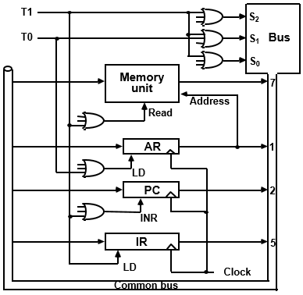
Register transfer for
Fetch Phase
Notes:
1.Place the content of PC onto the bus by making the bus selection inputs S2S1S0 equal to 010.
2. Transfer the content of the bus to AR by enabling the LD input of AR. The next clock transition initiates the transfer from PC to AR since T0 = 1.
In order to implement the second statement T1: IR ← M[AR], PC ← PC + 1 it is necessary to use timing signal T1 to provide the following connections in the bus system.
Enable the read input of memory.
2. Place the content of memory onto the bus by making S2S1S0 = 111.
3. Transfer the content of the bus to IR by enabling the LD input of IR.
4. Increment PC by enabling the INR input of PC. The next clock transition initiates the read and increment operations since T1 = 1 .

Slide 37
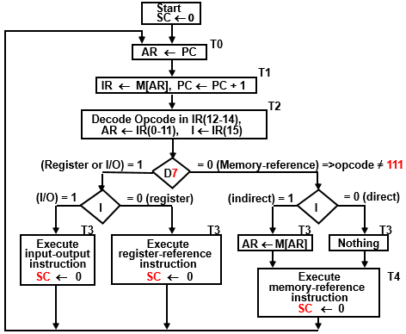

Determine the type of Instruction
Flowchart for Instruction cycle
Notes:
Decoder output D, is equal to 1 if the operation code is equal to binary 111. If D7 = I, the instruction must be a

Slide 38
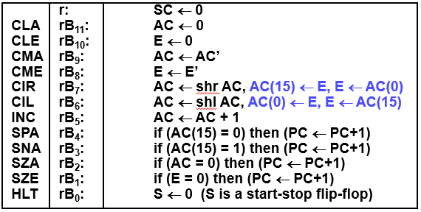
Register-Reference Instructions
Register Reference Instructions are identified when
- D7 = 1, I = 0
- Register Ref. Instr. is specified in b0 ~ b11 of IR
- Execution starts with timing signal T3
r = D7 I’T3 => Register Ref Instruction
Bi = IR(i) , i=0,1,2,...,11

Slide 39
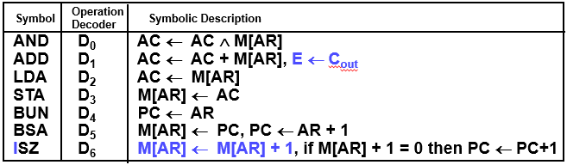
Memory Reference Instructions

Slide 40
Memory Reference Instructions
AND to AC
D0T4: DR ← M[AR] Read operand
D0T5: AC ← AC ^ DR, SC ← 0 AND with AC
ADD to AC
D1T4: DR ← M[AR] Read operand
D1T5: AC ← AC + DR, E ← Cout, SC ← 0 Add to AC and store carry in E
LDA: Load to AC
D2T4: DR ← M[AR]
D2T5: AC ← DR, SC ← 0
STA: Store AC
D3T4: M[AR] ← AC, SC ← 0
BUN: Branch Unconditionally
D4T4: PC ← AR, SC ← 0

Slide 41
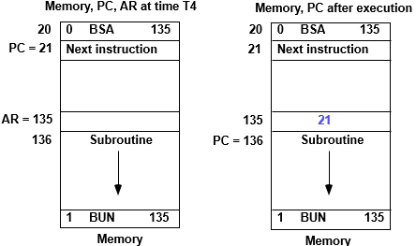
Memory Reference Instructions
BSA: Branch and Save Return Address
D5T4: M[AR] ← PC, AR ← AR + 1
D5T5: PC ← AR, SC ← 0

Slide 42
Memory Reference Instructions
ISZ: Increment and Skip-if-Zero
D6T4: DR ← M[AR]
D6T5: DR ← DR + 1
D6T4: M[AR] ← DR, if (DR = 0) then (PC ← PC + 1), SC ← 0

Slide 43
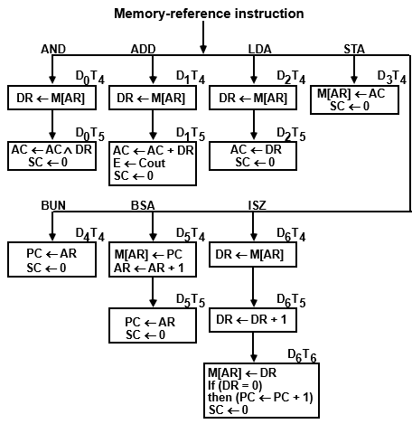
Memory Reference Instructions
Flowchart

Slide 44
INPUT-OUTPUT and INTERRUPT
A computer can serve no useful purpose unless it communicates with the external environment.
Instructions and data stored in memory must come from some input device.
Computational results must be transmitted to the user through some output device.
Commercial computers include many types of input and output devices.
To demonstrate the most basic requirements for input and output communication, we will use as an illustration a terminal unit with a keyboard and printer.

Slide 45
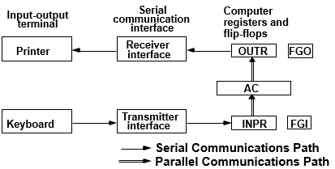
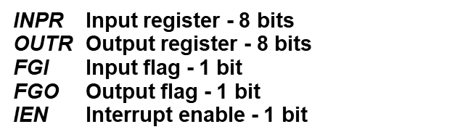
INPUT-OUTPUT Configuration
The terminal sends and receives serial information. Each quantity of information has eight bits of an alphanumeric code.
The serial information from the keyboard is shifted into the input register INPR.
The serial information for the printer is stored in the output register OUTR.
INPR and OUTR registers communicate with a communication interface serially and with the AC in parallel. The input-output configuration is shown in Figure.
The flags are needed to synchronize the timing difference between I/O device and the computer

Slide 46
INPUT-OUTPUT Configuration
The flag bit (FGI) is set to 1 when new information is available in the input device and is cleared to 0 when the information is accepted by the computer.
The computer checks the flag bit (FGO); if it is 1, the information from AC is transferred in parallel to OUTR and FGO is cleared to 0.
Notes:
The transmitter interface receives serial information from the keyboard and transmits it to INPR. The receiver interface receives information from OUTR and sends it to the printer serially. The input register INPR consists of eight bits and holds an alphanumeric input information. The 1-bit input flag FGI is a control flip-flop. The flag bit is set to 1 when new information is available in the input device and is cleared to 0 when the information is accepted by the computer. The flag is needed to synchronize the timing rate difference between the input device and the computer. The process of information transfer is as follows. Initially, the input flag FGI is cleared to 0. When a key is struck in the keyboard, an 8-bit alphanumeric code is shifted into INPR and the input flag FGI is set to 1. As long as the flag is set, the information in INPR cannot be changed by striking another key. The computer checks the flag bit; if it is 1, the information from INPR is transferred in parallel into AC and FGI is cleared to 0. Once the flag is cleared, new information can be shifted into INPR by striking another key. The output register OUTR works similarly but the direction of information flow is reversed. Initially, the output flag FGO is set to 1. The computer checks the flag bit; if it is 1, the information from AC is transferred in parallel to OUTR and FGO is cleared to 0. The output device accepts the coded information, prints the corresponding character, and when the operation is completed, it sets FGO to 1. The computer does not load a new character into OUTR when FGO is 0 because this condition indicates that the output device is in the process of printing the character.

Slide 47
INPUT-OUTPUT Instructions
D7 =1, I=1
D7IT3 = p
IR(i) = Bi, i = 6, …, 11
p: SC ← 0 Clear SC
INP pB₁₁: AC(0-7) ← INPR, FGI ← 0 Input char. to AC
OUT pB₁₀: OUTR ← AC(0-7), FGO ← 0 Output char. from AC
SKI pB₉: if(FGI = 1) then (PC ← PC + 1) Skip on input flag
SKO pB₈: if(FGO = 1) then (PC ← PC + 1) Skip on output flag
ION pB₇: IEN ← 1 Interrupt enable on
IOF pB₆: IEN ← 0 Interrupt enable off

Slide 48
Communication with I/O
Two ways → 1) Programmed I/O
2) Interrupt I/O
Programmed I/O:
BACK: SKI
BUN BACK
INP
Input-output device can transfer information at a maximum rate of 10 characters per second. → equivalent to one character every 100,000 uS.
Two instructions are executed when the computer checks the flag bit and decides not to transfer the information.
This means that at the maximum rate, the computer will check the flag 50,000 times between each transfer.
The computer is wasting time while checking the flag instead of doing some other useful processing task.

Slide 49
Program Interrupt
Open communication only when some data has to be passed --> interrupt.
The I/O interface, instead of the CPU, monitors the I/O device.
When the interface founds that the I/O device is ready for data transfer, it generates an interrupt request to the CPU
Upon detecting an interrupt, the CPU stops momentarily the task
it is doing, branches to the service routine to process the data transfer, and then returns to the task it was performing.
IEN (Interrupt-enable flip-flop)
can be set and cleared by instructions
when cleared, the computer cannot be interrupted

Slide 50
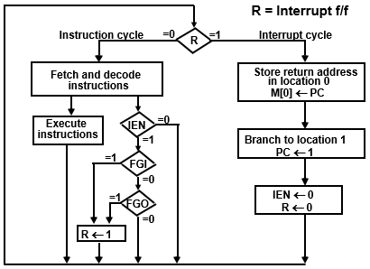

Flowchart for Interrupt Cycle

Slide 51
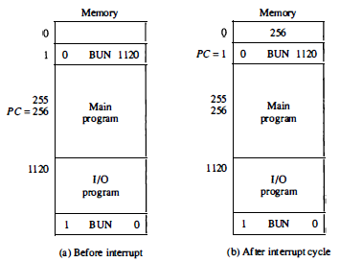
Interrupt Cycle

Slide 52
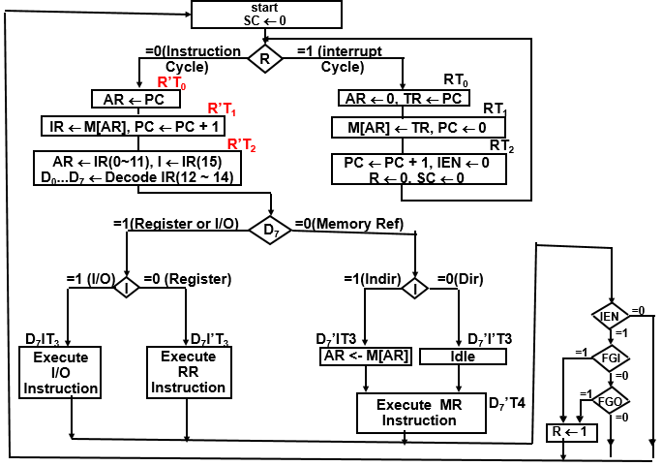
Complete Computer Description
Notes:
The basic computer consists of the following hardware components:
1. A memory unit with 4096 words of 16 bits each
2. Nine registers: AR, PC, DR, AC, IR, TR, OUTR, INPR, and SC
3. Seven flip-flops: I, S , E, R, lEN, FGI, and FGO
4. Two decoders: a 3 x 8 operation decoder and a 4 x 16 timing decoder
5. A 16-bit common bus
6. Control logic gates
7. Adder and logic circuit connected to the input of AC

